Slide 1
Disruption: past, present and future
DuWayne Peterson, former EVP & CIO, Merrill-Lynch Brad Peterson, EVP & CTO/CIO, NASDAQ September 29, 2016

Slide 2
The Graduate (1967)
“One Word: Plastics”

Slide 3
PAST

Slide 4
Boom Town: Detroit in the 60s
Detroit

Slide 5
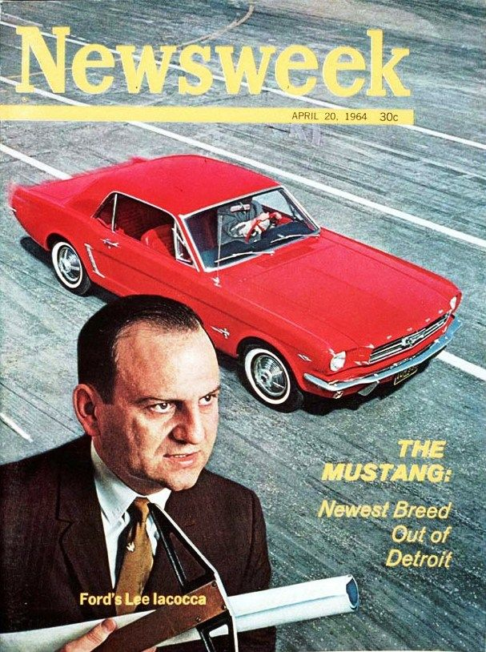
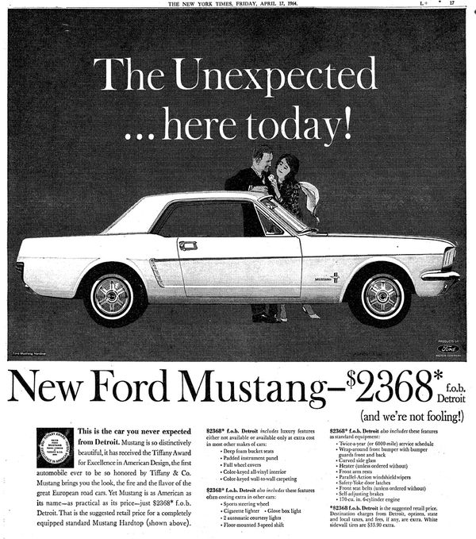
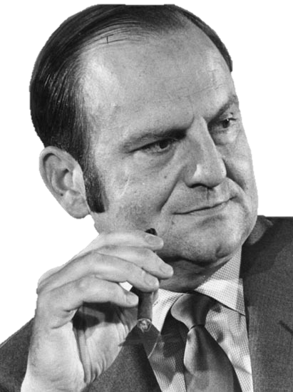
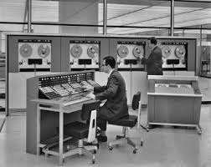
Birth of the mustang?
Lee Iacocca
Former Chrysler Chairman
Former Ford President

Slide 6
Birth of the mustang?

Slide 7
Competitive threat?
Volvo invented the world’s first 3-Point Safety Belt
in 1959.
Then Volvo gave the
invention to the world
for free.
Nils Bohlin,
Gotenburg, Sweden, 1959
GERMAN VOLVO ENGINEER CREATES
THE SAFETY BELT
1965 “UNSAFE AT ANY SPEED”
CHANGES THE AUTO INDUSTRY

Slide 8
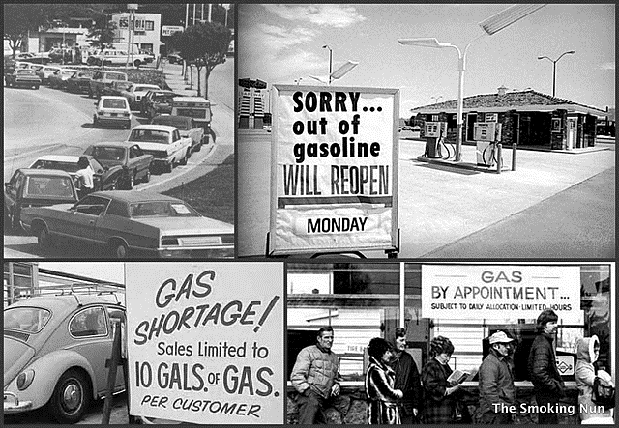
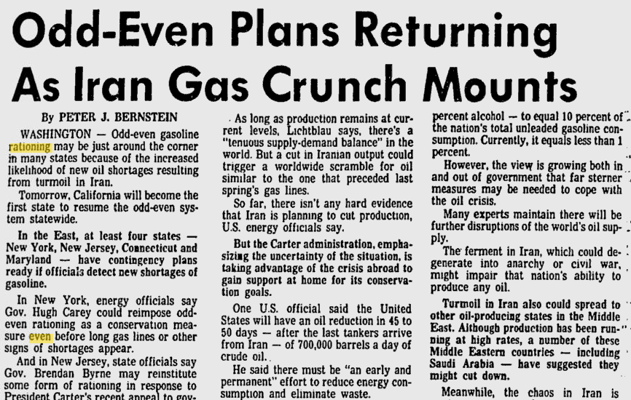
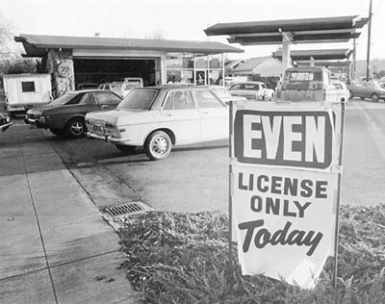
1973 OIL CRISIS
1970s FOREIGN COMPETITION –
FUEL EFFICIENT CARS

Slide 9
PRESENT

Slide 10
Innovation is centered in…
California

Slide 11
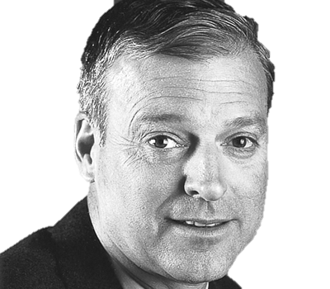
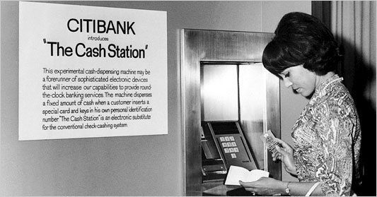
RISE of the ATM and a Technology pioneer and leader rises fast in the financial services industry
John
John Reed
Former CEO of Citigroup
Chairman, Massachusetts Institute of Technology Board of Trustees

Slide 12
Atm growth and usage in the US plateaus
425,000 -
- 15 Billion
ATMs
Transactions
0 -
- 0
1967
1999
2008
2015
Source: CreditCards.com

Slide 13
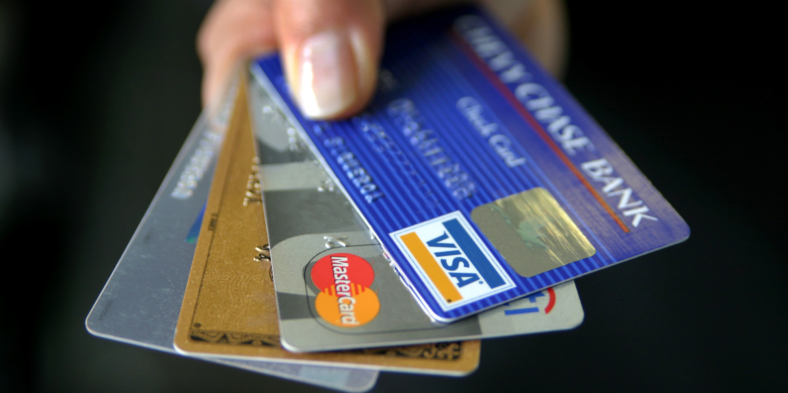
SMARTPhone and APP innovation obviates need for cash
INNOVATIONS IN TECHNOLOGY REPLACE MOST ATM FUNCTIONALITY

Slide 14
What was once your strategic advantage can become your albatross
ATM transactions are declining, and the number of ATMs have plateaued.
These firms have collectively 81,000 ATMs at a conservative annual operating cost of approximately $1 billion.

Slide 15
FUTURE

Slide 16
Boom Town: The world
Amsterdam
Berlin
Boston
Chicago
Copenhagen
London
Munich
New York
Paris
San Francisco
Seattle
Seoul
Shanghai
Singapore
Stockholm
Sydney
Tel Aviv
Tokyo
Toronto
Vienna

Slide 17
Identify the landscape

Slide 18
Technology trends shaping financial services?
Innovations Advancing The FinTech Landscape
CLOUD
SERVICES
SMARTPHONE ECOSYSTEM
BLOCKCHAIN
MACHINE INTELLIGENCE
QUANTUM COMPUTING
CRYPTOGRAPHY
AUGMENTED REALITY /
VIRTUAL
REALITY
BIG DATA
MICROSERVICES

Slide 19
Be aware of exponential improvements
in technology and their application
to your industry

Slide 20
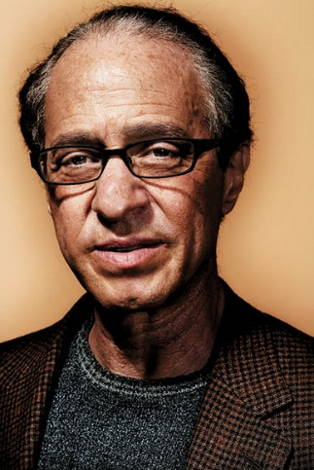
Singularity is near
Law of Accelerating Returns is the reason why information technologies grow exponentially, and they’ll not only impact businesses but what makes us human.
Information technology progresses exponentially…30 steps linearly gets you to 30. 1, 2, 3….you’re at 30. With exponential growth, it’s 1, 2, 4, 8…step 30, you’re at a billion.
Current exponential growth of computing will continue and human-level intelligence will be eclipsed as early as 2029.
Ray Kurzweil
Scientist, Inventor, Futurist

Slide 21
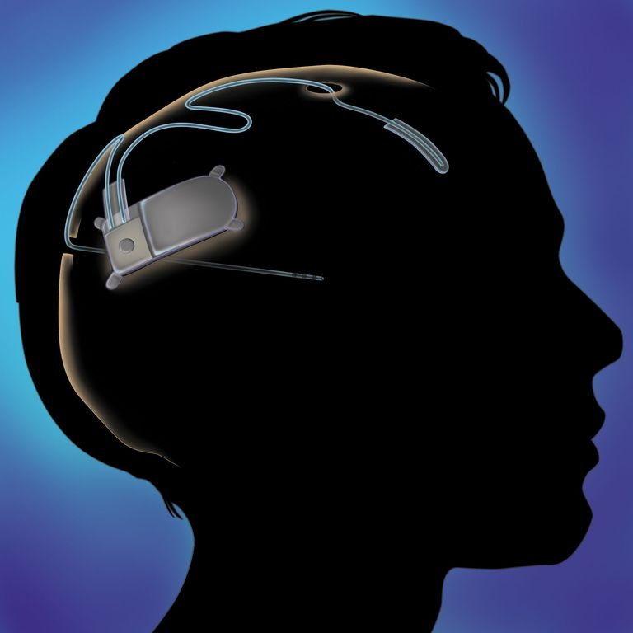
Technology continues to advance exponentially
The following predictions regarding exponential technologies were made by Ray Kurzweil.
The following predictions regarding exponential technologies were made by Ray Kurzweil.
2029
Software is
Software is autonomously learning and creating new knowledge
A $1,000 computer is now 1,000x more powerful than the human brain
VR eyeglasses and headphones are replaced with
computer implants
He has made 147 predictions since the 1990's and has maintained an
astonishing 86% accuracy rate.

Slide 22
Apply the Varian Rule to round out
your technology vision

Slide 23
Varian rule
A simple way to forecast the future is to look at what wealthy people have today; middle-income people will have something equivalent in 10 years, and the rest of the population will have in an additional decade.
Hal R. Varian
Chief Economist
at Google

Slide 24
Varian rule
What do wealthy people have access to? Private Drivers / Chauffeurs…
“A simple way to forecast the future is to look at what wealthy people have today; middle-income people will have something equivalent in 10 years, and the rest of the population will have in an additional decade.”
“A simple way to forecast the future is to look at what rich people have today; middle-income people will have something equivalent in 10 years, and poor people will have it in an additional decade.”
Hal R. Varian
Chief Economist at Google

Slide 25
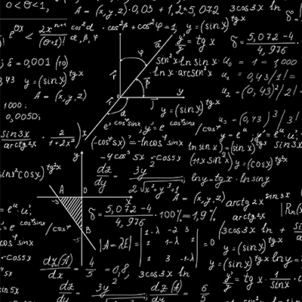
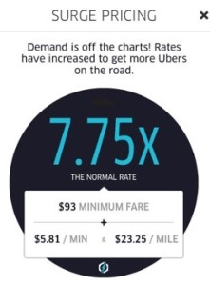
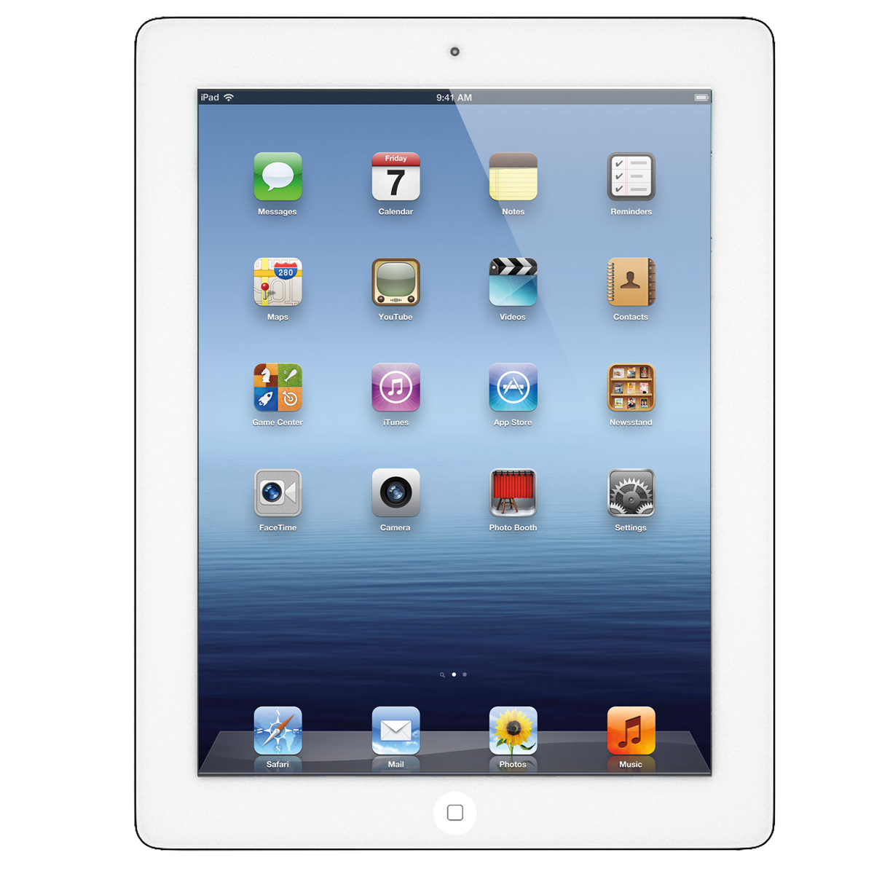
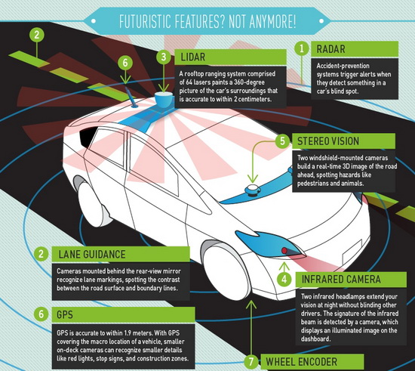
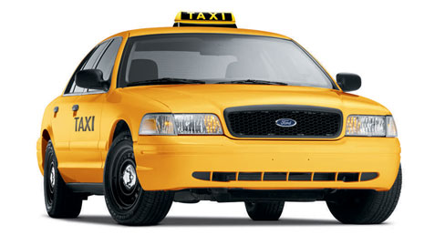
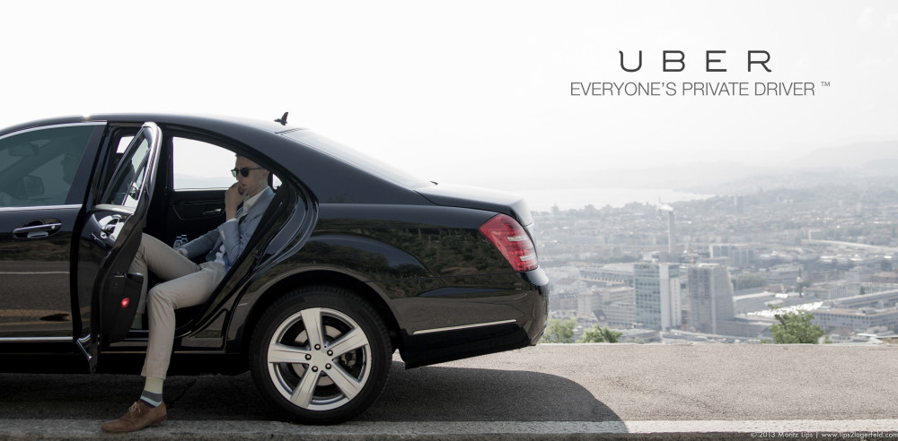
The art of the possible
LINEAR GROWTH
EXPONENTIAL GROWTH
Uber is riding the exponential curve and disrupting the transportation industry!
Taxi Industry
Sensors
Lidar
Radar
GPS
Guidance
Clustering
Algorithms
Surge
Pricing
Smartphone
Uber will eventually replace all its drivers with self-driving cars
Mapping Software
Linear thinking companies
get displaced by
exponential technologies
Everyone’s Private Driver

Slide 26
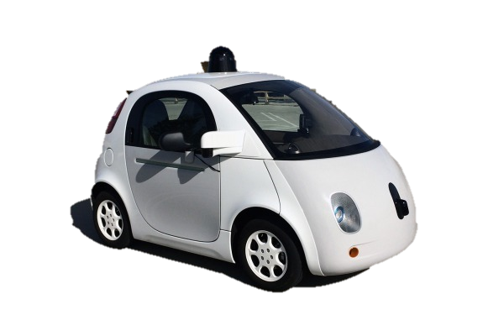
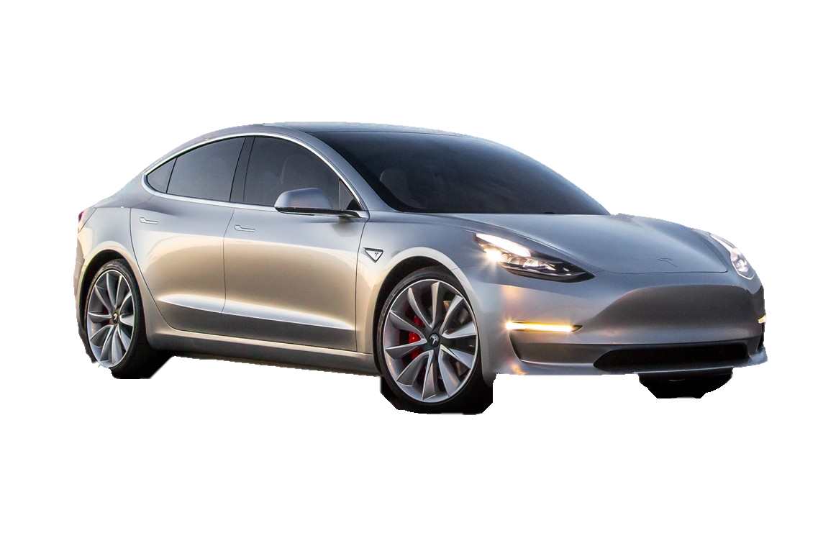
Internet of things Google Self- Driving Car Tesla
Tesla Model 3:
400,000 preordered units that representing a sales backlog of $14 billion.

Slide 27
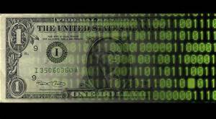
The art of the possible
z
LINEAR GROWTH
EXPONENTIAL GROWTH
Financial Industry
Linear thinking companies
get displaced by
exponential technologies
AI Enabled Financial Services
Investments Optimized for Taxes and Long Term Return
Smart
Alpha
Daily Living
and Life’s
Expenses
Venture Capital
Wealth Management
Hedge Funds
ETFs
Mutual Funds
ETFs
Mutual Funds
Robo-advised Asset Allocation
and Diversification
Notes:
Create slide with
3 different sections – wealth people with 3 things I have, m
Middle would be ETFs, Mutual Funds and swap etrade and ameretrade
Robo advisors, smart data, smart alpha – this will all innovate the types of products that people use. Disruptive robo advisors (sshwabb intelligent portfolios)

Slide 28
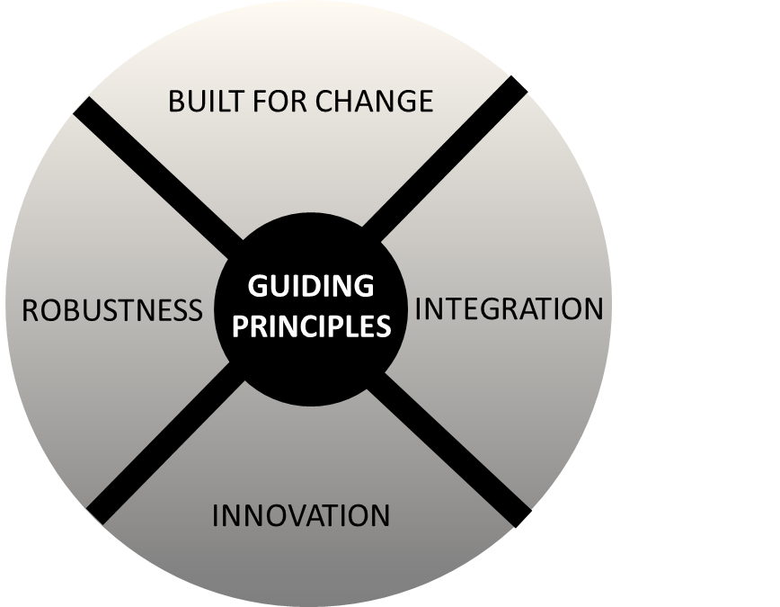
AMPLIFIED DISRUPTIVE TECHNOLOGY IN TRANSPORTATION
Smart Phone
Uber
Waze
Driverless Car
AMPLIFIED DISRUPTIVE TECHNOLOGY IN MARKETS
Direct Investor Interaction
Nasdaq Financial Framework
Electronic Execution and Recordkeeping
(Blockchain)
Notes:
https://prezi.com/eroq_rqr0lkd/emerging-technology-trends-of-2020/

Slide 29
As you are thinking about your future
And lastly, always ask yourself….
Identify the landscape
Be aware of exponential improvement
Apply the Varian Rule to round out your technology visions

Slide 30
What’s today’s Plastic?

